Slide 1
DELE CA1
P2518031- Phan Jun Hao

Slide 2
CNN – EDA and Background research
The initial phase of the project focused on data auditing and structural preparation of the EMNIST Letters dataset. To ensure high data quality, I performed a cleaning step to filter out non-positive labels, isolating the 26 valid letter classes (A-Z) and removing potential background noise or metadata. Descriptive statistics and class distribution visualizations confirmed that the dataset is well-balanced, which is essential for preventing model bias toward specific characters. Crucially, I identified that EMNIST data is stored in a column-major format; I addressed this by transposing the pixel matrices into a standard row-major orientation. This structural alignment is a vital step for Convolutional Neural Networks (CNNs), as it ensures that spatial features (such as the curves and lines of handwritten characters) are correctly interpreted by the model's filters.

Slide 3
Feature engineering
To optimize the raw data for deep learning, I implemented a robust feature engineering pipeline. This included normalization, scaling pixel intensities to a [0, 1] range to accelerate gradient descent convergence, and one-hot encoding of labels to facilitate categorical classification across 26 classes. To meet the specific requirements of the Convolutional Neural Network (CNN), I restored the spatial structure of the data by reshaping the flattened inputs into 28×28 matrices and expanding the dimensions to a 4D format (28×28×1) to accommodate the required grayscale channel. Finally, the dataset was partitioned into training and validation sets to allow for objective performance monitoring and the implementation of a ModelCheckpoint callback.

Slide 4
Modelling and evaluation
To establish a performance benchmark, I developed a baseline Convolutional Neural Network (CNN) architecture. The model employs Convolutional layers for hierarchical feature extraction, Max-Pooling for spatial dimensionality reduction, and Dropout (0.2) as a regularization technique to mitigate overfitting. The architecture concludes with a fully connected Dense layer to map extracted features to the 26 target character classes. This baseline model achieved a validation accuracy of 91.77% after 20 epochs. While this performance is strong, the observed gap between training and validation accuracy, along with the engagement of EarlyStopping, suggests that the model is nearing its capacity for generalization."

Slide 5
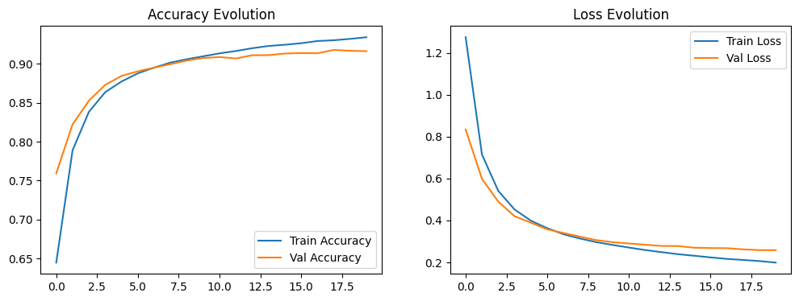
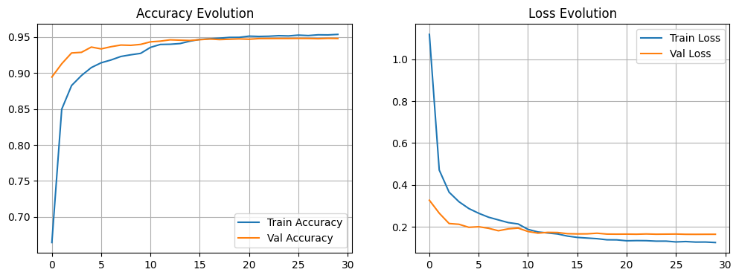
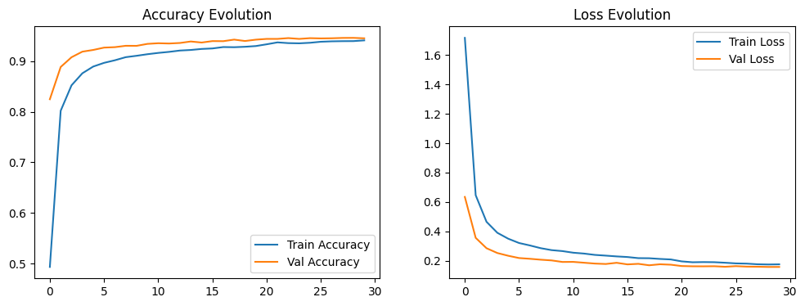
Model improvement 1
The Baseline Problem: High sensitivity to overfitting and confusion between structurally similar characters (e.g., 'O' vs. 'D').
Complex CNN (94.86%): * Deepened Architecture: Introduced a block-based design for hierarchical feature extraction (edges to shapes).
Stabilization: Integrated BatchNormalization and graduated Dropout (0.25–0.40) to force redundant feature learning and stabilize training.
Refined CNN (94.50%): * Architectural Efficiency: Replaced Flatten() with GlobalAveragePooling2D().
The Benefit: Drastically reduced parameter count, acting as a structural regularizer that improved stability and generalization.

Slide 6
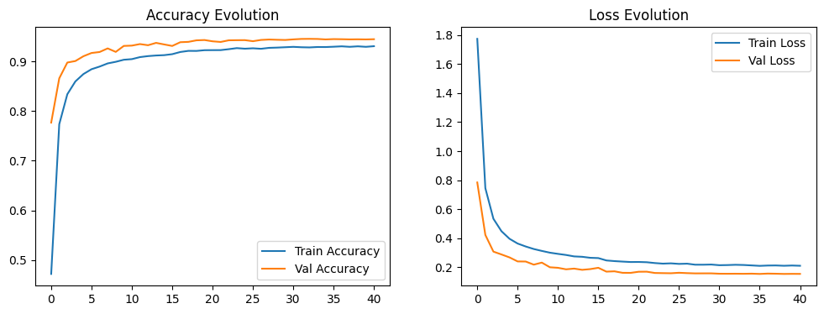
Model improvement - 2
Data Augmentation: Introduced real-time rotations, zooms, and shifts.
Why? To force the model to learn invariant features regardless of orientation or positioning.
Adaptive Training Strategy: * ReduceLROnPlateau: Dynamically adjusted learning rates to navigate the loss landscape, ensuring convergence even in complex augmented data.
ModelCheckpoint: Safeguarded the "best version" of the model, ignoring performance degradation in final epochs.

Slide 7
RNN – EDA and Background Research
To ensure the RNN models are trained on high-fidelity linguistic data, I conducted a rigorous data auditing and cleaning process. I addressed structural issues by removing duplicate records, dropping incomplete entries, and correcting data types to ensure the 'Score' column was numeric and within a valid range. A key decision was to refine the dataset's scope by filtering for English and Malay reviews, which mitigates language-specific noise and allows for more focused sentiment learning. By mapping numerical scores to 'Positive,' 'Neutral,' and 'Negative' categories, I transformed a regression problem into a balanced multi-class classification task, enabling the model to learn distinct sentiment patterns rather than granular variations.

Slide 8
Feature engineering
To translate raw, heterogeneous pizza reviews into a format suitable for Recurrent Neural Network (RNN) training, I implemented a comprehensive multi-stage pipeline. I first normalized the dataset by translating all Malay reviews into English, ensuring linguistic consistency. I then performed text cleaning, such as converting text to lowercase, expanding contractions, and stripping non-alphabetic characters to reduce vocabulary noise. Following this, I employed Tokenizer to convert words into numerical indices and applied Padding to standardise all review sequences to a fixed length of 100 tokens. This transformation converts unstructured text into fixed-size tensors, allowing the RNN to process sequences of uniform shape while focusing on the most relevant features learned from the corpus vocabulary.

Slide 9
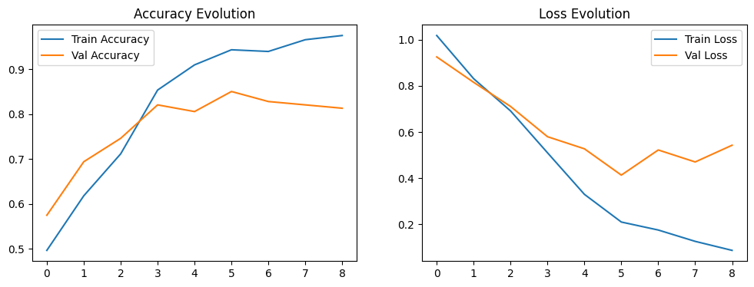
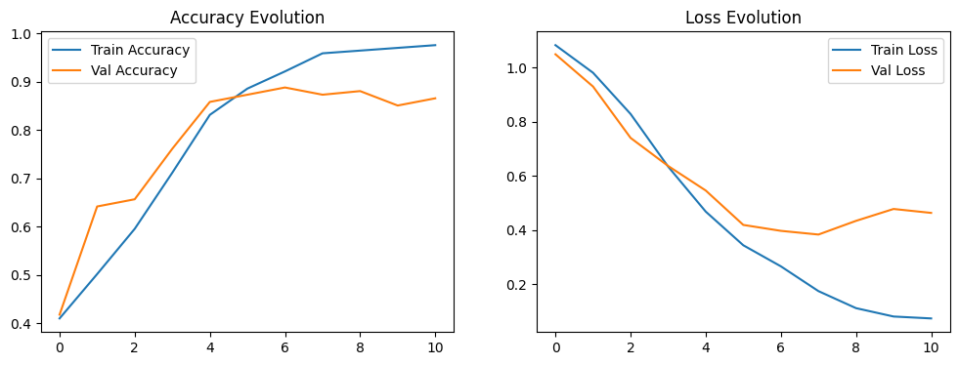
Modelling and evaluation
To establish a performance baseline for pizza review sentiment analysis, I implemented a SimpleRNN architecture, which provided a foundational accuracy of ~86.8%. While effective, the baseline showed significant signs of overfitting, as indicated by the widening gap between training and validation loss curves. Transitioning to an LSTM architecture helped capture longer-range dependencies, yet the model continued to exhibit high variance in validation loss. This trend confirms that while the model has successfully identified core sentiment signals, it is currently limited by its sensitivity to training noise rather than a lack of capacity. Consequently, the evaluation of these initial models validates the necessity for architectural enhancements, such as Bidirectional layers and L2 regularization, to improve generalization on unseen review data.

Slide 10
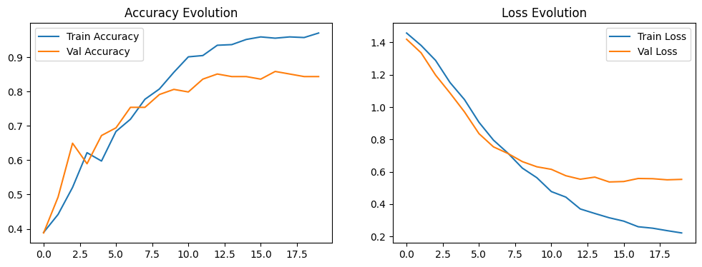
Model improvement
To move beyond the baseline’s limitations, I implemented a Bidirectional LSTM architecture. Unlike unidirectional models, this approach processes text in both forward and backward directions, allowing the network to capture essential context such as negations or descriptive adjectives that define sentiment. I addressed the overfitting observed in the baseline by introducing multi-layered regularization: Dropout (0.4/0.2) to prevent neuron co-adaptation and L2 weight regularization to constrain weight magnitude. Training was further stabilized using adaptive callbacks, including ReduceLROnPlateau for precise learning rate tuning and EarlyStopping to prevent over-training

Slide 11
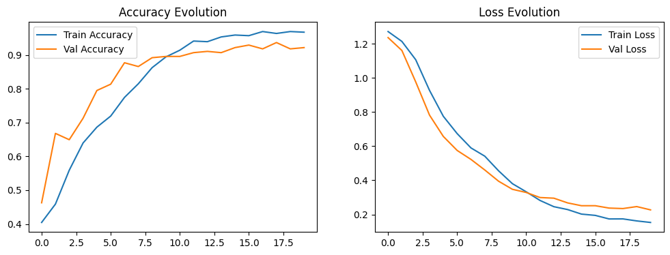
Model improvement 2
To further improve the model's robustness and address the constraints of the provided dataset, I implemented Data Augmentation through Synonym Replacement. Using the WordNet library, I synthetically generated new training examples by swapping key terms in the existing reviews for their synonyms. This technique artificially expanded our training corpus and forced the model to learn invariant sentiment features, ensuring that it relies on the underlying meaning of words rather than specific vocabulary patterns. By doubling the training samples through this augmentation, the model achieved greater resilience to variations in language and consumer review style.

